Slide 1
Ifstream, ofstream
Slides by Varick and Ashley Erickson
© Varick and Ashley Erickson

Slide 2
Objectives

Slide 3
ifstream and ofstream
ifstream → input file stream
ofstream → output file stream
You will need to include the fstream library
#include <fstream>

Slide 4
ofstream
ofstream objects are used to write to a file.
If you know how to use cout, then you already know how to use ofstream.

Slide 5
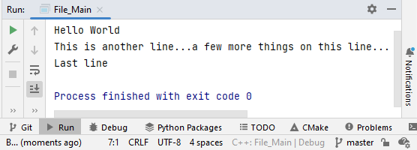
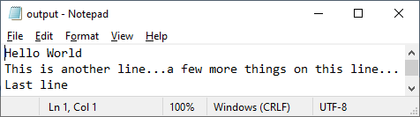
ofstream
ofstream
cout
ofstream outputFile; outputFile.open("output.txt"); outputFile << "Hello World" << endl; outputFile << "This is another line..."; outputFile << "a few more things on this line..." << endl; outputFile << "Last line" << endl;
outputFile.close();
Notice similarity between cout and ofstream usage
cout << "Hello World" << endl; cout << "This is another line..."; cout << "a few more things on this line..." << endl; cout << "Last line" << endl;

Slide 6
ifstream
ifstream objects are used to write to a file.
If you know how to use cin, then you already know how to use ifstream.

Slide 7
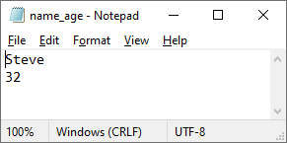
ifstream
ifstream
cin
string name; int age;
ifstream userFile; userFile.open("name_age.txt");
// Get values from name_age.txt file userFile >> name; userFile >> age; userFile.close(); // Done with file
cin gets values from the user
ifstream gets values from a file.
string name; int age; // Get values from user cout << "What is your name? "; cin >> name; // Gets name from user cout << "How old are you? "; cin >> age; // Gets age from user

Slide 8
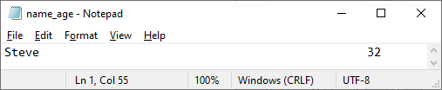
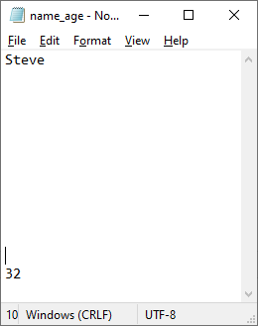
ifstream ignores whitespace
string name; int age;
ifstream userFile; userFile.open("name_age.txt");
// Get values from name_age.txt file userFile >> name; userFile >> age; userFile.close(); // Done with file
ifstream has the same behavior as cin
ifstream skips over whitespace
All three of these files would be read the same

Slide 9
Automatic type conversion
ifstream type conversion works the same as cin type conversion
ifstream will perform automatic type conversion for primitive types
string name; int age;
ifstream userFile; userFile.open("name_age.txt");
// Get values from name_age.txt file userFile >> name; userFile >> age; userFile.close(); // Done with file

Slide 10
Both of these are the same
string name; int age;
ifstream userFile; userFile.open("name_age.txt");
// Get values from name_age.txt file userFile >> name; userFile >> age; userFile.close(); // Done with file
string name; int age;
ifstream userFile; userFile.open("name_age.txt");
// Get values from name_age.txt file userFile >> name >> age; userFile.close(); // Done with file

Slide 11
Examples
The next few slides will show some common “patterns” you will encounter

Slide 12
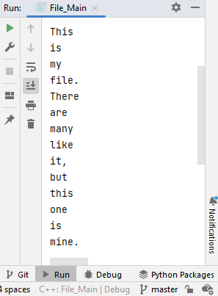
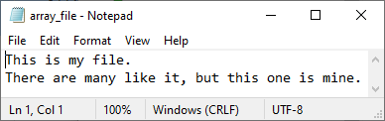
Reading all words in a file
ifstream inputFile; inputFile.open("array_file.txt"); string word; while (inputFile >> word) { cout << word << endl; }
inputFile >> word returns 0 if there are no words to read
Notes:
This
is
my
file.
there
are many
like it,
but
this
one
is
mine.

Slide 13
Read all the words into an array
string words[20]; ifstream inputFile; inputFile.open("array_file.txt"); string word; int i = 0; while (inputFile >> word) { words[i] = word; i++; }

Slide 14
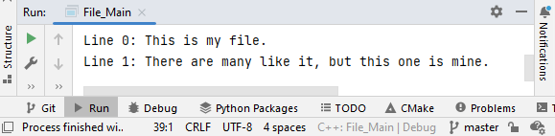
Reading all the lines in a file
ifstream myFile; myFile.open("array_file.txt"); string line; i = 0; while (getline(myFile, line)) { cout << "Line " << i << ": " << line << endl; i++; }
Note you still have limitations with getline
You are not able to do automatic type conversion

Slide 15
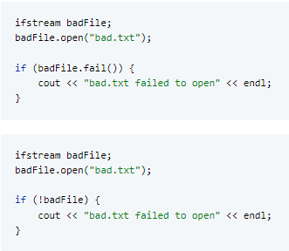
Checking if a file opened properly

